Slide 1







TrafficFlow AI
Team Name:HACKZILLA
Team Leader Name:Monishwar S
Teammates Name:Prachith Balaji G, Navaneethan N S
College Name:KPR Institute of Engineering and Technology

Slide 2
PROBLEM STATEMENT
The Urban Gridlock: Commuters drain an average of 99 hours yearly in gridlock across major metropolitan areas, wasting time and fueling frustration.
Environmental Impact: Each stalled trip hikes fuel consumption and emissions by roughly 20%, significantly decreasing urban air quality.
Public Safety Risks: Chronic delays push emergency responders off target, turning minor delays into life-threatening bottlenecks.
The Core Flaw: Existing systems rely on centralized servers that react slowly, fail at scale, and create massive points of failure for entire city grids.

Slide 3
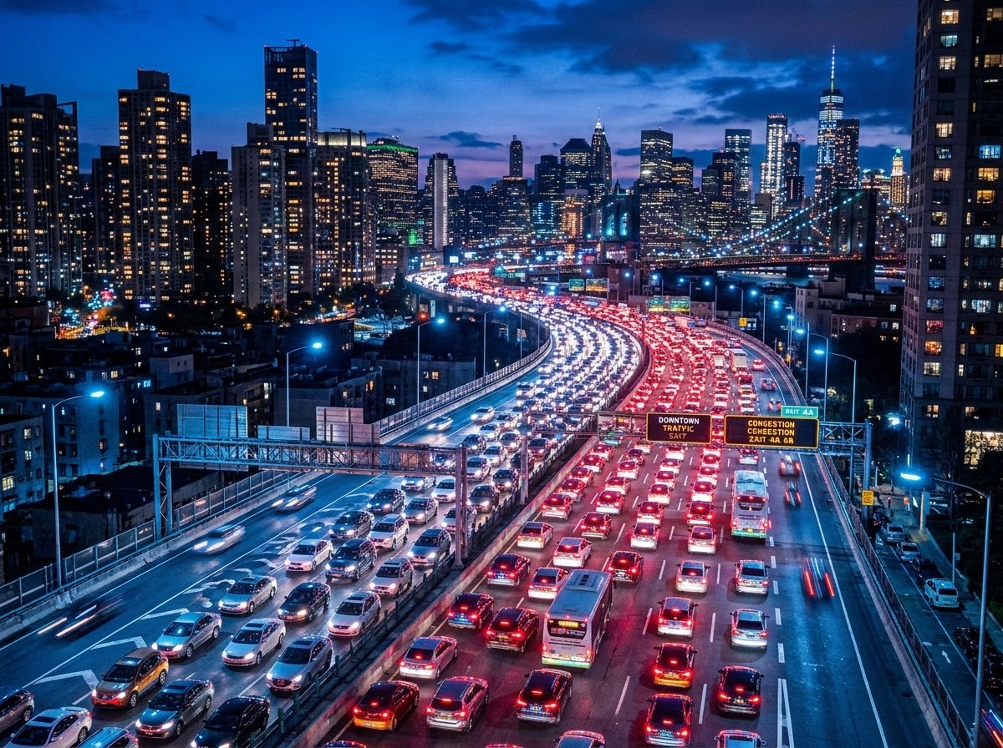
PROBLEM STATEMENT
01 / The Urban Gridlock
Commuters drain an average of 99 hours yearly in gridlock across major metropolitan areas, wasting time and fueling frustration.
02 / Environmental Impact
Each stalled trip hikes fuel consumption and emissions by roughly 20%, significantly decreasing urban air quality.
03 / Public Safety Risks
Chronic delays push emergency responders off target, turning minor delays into life-threatening bottlenecks.
04 / The Core Flaw
Existing systems rely on centralized servers that react slowly, fail at scale, and create massive points of failure.

Slide 4
ABSTRACT
Core Architectural Advantages Edge-Native Processing:
AI inference runs directly at intersections.
Zero Single Point of Failure: System operates if central network fails.
Connected Node Network: Signals continuously exchange local traffic data.
Performance & Sustainability Impact Millisecond-Level Decisions:
Drastically lowers communication latency.
Proactive Congestion Relief: Clears routes before bottlenecks form. Environmental Benefits:
Reduces fuel consumption and idle emissions.
Emergency Vehicle Priority: Optimizes routes for rapid response.

Slide 5

ABSTRACT
01 / EDGE-NATIVE INTELLIGENCE
Decentralized Real-Time Inference
TrafficFlow AI performs inference directly at each intersection, enabling millisecond-level decisions and continued operations even during network failures.
02 / PROACTIVE OPTIMIZATION
Predictive Queue & Signal Control
Continuously exchanges local data to predict vehicle platoons and clear routes before congestion forms, minimizing travel delays.
03 / SMART CITY SYNERGY
Scalable & Resilient Architecture
Eliminates single points of failure to deliver high scalability, lower emissions, and improved emergency vehicle routing.

Slide 6
Edge Inference: Compact ML models deployed on lightweight edge nodes (e.g., NVIDIA Jetson) for ultra-low latency predictions.
Mesh Networking: Low-latency peer-to-peer protocols (MQTT/CoAP) used strictly for intersection-to-intersection state communication.
Sensor Fusion: Integration of radar, intelligent cameras, and legacy loop data to stream robust, anonymized vehicle tracking.
City Cloud Learning: Federated periodic model updates and long-term KPI analytics processed in the cloud for systemic improvements.
TECH STACK

Slide 7
The Status Quo: Legacy systems (SCATS / SCOOT) rely heavily on central servers with fixed or slowly adapting timing algorithms.
Treat intersections as isolated nodes.
High dependency on mainframe connection.
Rule-based rather than predictive.
Critical Drawbacks:
Single Point Failure: Outages paralyze the city.
High Latency: Struggles to react to anomalies.
Symptom Management: Blindly pushes traffic to the next signal, creating cascading bottlenecks rather than solving route flow.
EXISTING SOLUTIONS & DRAWBACKS

Slide 8
Traffic Flow AI decentralizes traffic management by placing AI intelligence directly at every intersection. Instead of transmitting all traffic data to a central server for processing, each edge node performs real-time inference using local sensor data and communicates only essential traffic information with neighboring intersections. This architecture enables millisecond-level decision making, minimizes communication delays, and ensures uninterrupted operation even if individual nodes or network links fail.
Unlike conventional adaptive traffic systems that simply push vehicles to the next intersection, TrafficFlow AI coordinates a network of intelligent signals to compute the globally optimal traffic path. Each intersection considers downstream road capacity, predicted traffic density, and neighboring signal states before making decisions. By anticipating congestion rather than merely reacting to it, the system prevents bottlenecks from forming, distributes traffic more efficiently across the network, and enables smoother travel, faster emergency response, and improved city-wide traffic flow.
PROPOSED SOLUTION

Slide 9
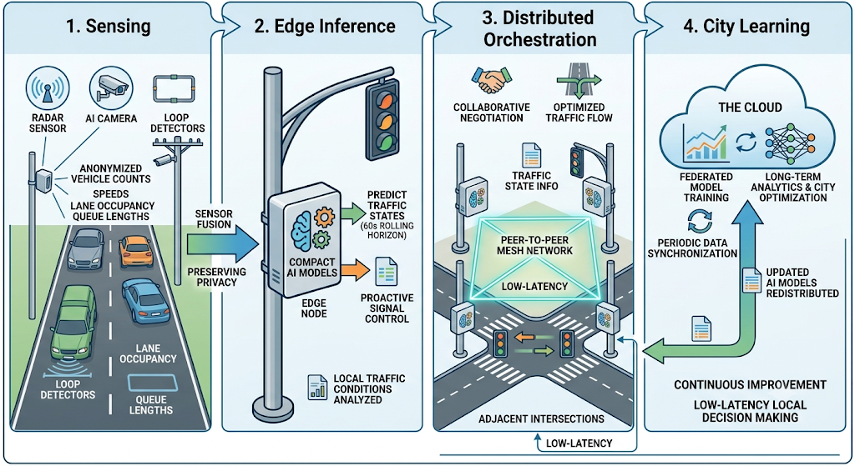
1. Sensing: Radar, camera + AI
2. Inference: Compact models locally predict traffic state on a 60s rolling horizon.
3. Orchestration: Adjacent nodes negotiate phase adjustments via peer mesh protocol.
4. City Learning: Periodic model updates and analytics distributed via the cloud.
ARCHITECTURE / WORKFLOW
Sample AI Generated Image

Slide 10
Global Path Optimization: Evaluates the grid as a holistic network, proactively adjusting downstream lights before a platoon of cars even arrives.
Graceful Degradation: No central dependency. If one intersection loses connectivity, the rest of the grid continues to optimize autonomously.
Millisecond Decisions: Edge hardware eliminates cloud round-trip latency, allowing phase changes to happen the exact instant conditions demand it.
Emissions Mitigation: By targeting "stops per kilometer" as a primary penalty in our reward function, we directly cut idling CO2 emissions.
UNIQUENESS / INNOVATION

Slide 11
Advantages (Target Pilot Metrics):
15% Delay Reduction: Target drop from 45s to ~38s per vehicle.
20% Stop Reduction: Smoother flow reduces total stops per kilometer.
~8% Emissions Cut: Measurable CO2 reduction; ROI in 6-9 months.
Current Limitations:
Hardware Overhead: Requires installation of edge nodes at each junction.
Sensor Dependency: Algorithm efficacy drops if existing sensors fail.
Initial Calibration Phase: Models require 48-72h to map local behaviors.
ADVANTAGES & LIMITATIONS

Slide 12
"Local optimization compounds into city-wide improvements."
TrafficFlow AI demonstrates how decentralized intelligence can transform urban mobility. By replacing centralized bottlenecks with edge-native AI and collaborative intersection-to-intersection coordination, the system delivers faster decision making, greater resilience, and proactive traffic optimization at city scale. Each intersection independently optimizes local traffic while contributing to a coordinated network that improves overall traffic flow, reduces congestion, lowers emissions, and enhances emergency response efficiency.
The architecture is inherently scalable, allowing deployment to begin with a single intersection or corridor and expand seamlessly to an entire metropolitan road network without fundamental infrastructure changes. This provides municipalities with a practical and cost-effective path toward building smarter, more resilient cities.
Call to Action
Ready for a 48-Hour Pilot Deployment
Deploy TrafficFlow AI at a selected traffic corridor and demonstrate measurable improvements in traffic flow, travel time, fuel efficiency, and emissions within just 48 hours, providing a clear roadmap for city-wide adopt.
CONCLUSION

Slide 13
REFERENCES
Zhou, P., etc. (2020). Multi-Agent Deep Reinforcement Learning for Large-Scale Traffic Signal Control. IEEE Transactions on Intelligent Transportation Systems, 21(8).
IEEE Standards Association. (2024). IEEE P3342: Standard for Base Framework of Edge AI Model Deployment and Management. IEEE Xplore Standards.
Federal Highway Administration (FHWA). (2022). 2021 Urban Congestion Trends Report. U.S. Department of Transportation.
Use an open-source industry standard benchmark instead:
Eclipse Foundation. (2025). Simulation of Urban MObility (SUMO) Traffic Optimization Framework.

